Slide 2
Monthly Cyber Briefing
April 2023: Managing Risk Across the Healthcare Ecosystem
Moderator: Lauren Frickle

Slide 3





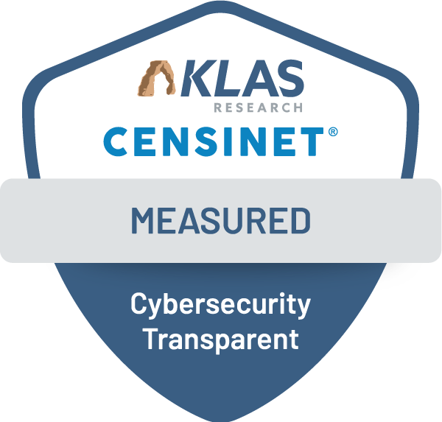
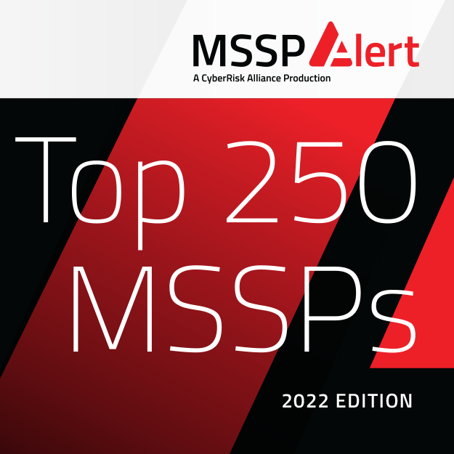
Leading provider of cybersecurity consulting and managed services, fully focused on the healthcare industry
500+ active customers across the healthcare ecosystem
~200 colleagues with 100+ expert cybersecurity & privacy consultants
Clearwater has become a leading healthcare cybersecurity, privacy, and compliance solutions provider with 500+ customers and multiple awards, including Best in KLAS for Cybersecurity Advisory Services, top performer in a 2022 KLAS Research report, and top Compliance and Risk Management solution provider for 6 years in a row.

Slide 4

Logistics
All attendees in “Listen Only Mode”
Please ask content related questions in Q&A
Cyber Briefings are eligible for HIMSS & CHIME CE credit
Recording and final slides shared within 48 hours

Slide 5



April’s Panelists
Steve Cagle, MBA, HCISPP
Chief Executive Officer
Clearwater
Andrew Mahler, CHC, CIPP/US,CHC, CHPC, CHRC
VP, Consulting Services,
Privacy & Compliance
Clearwater
Dave Bailey, CISSP
VP, Consulting Services, Security Clearwater

Slide 6
Cyber Update
Steve Cagle

Slide 7
Vendors in Healthcare Are More Targeted Than Ever Before…
34%
of third-party breaches across all industries occurred in healthcare
90%
largest healthcare breaches of 2022 were third-party breaches
2X
Third-party breaches in healthcare are growing – nearly twice as many victims in 2022 as 2021

Slide 8
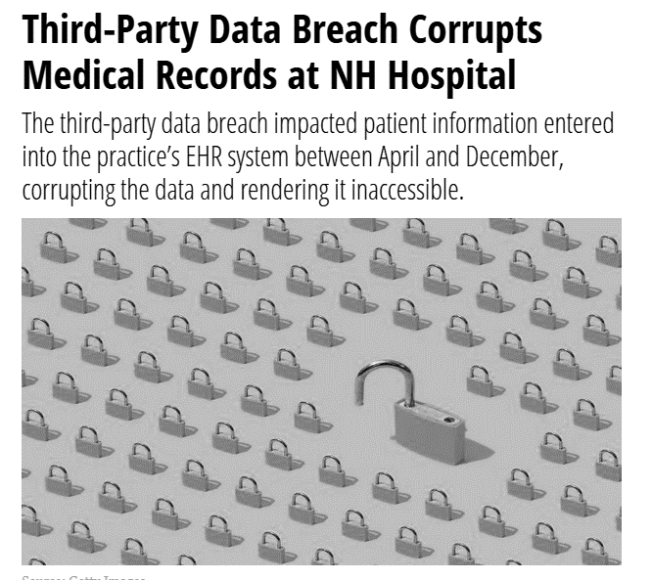
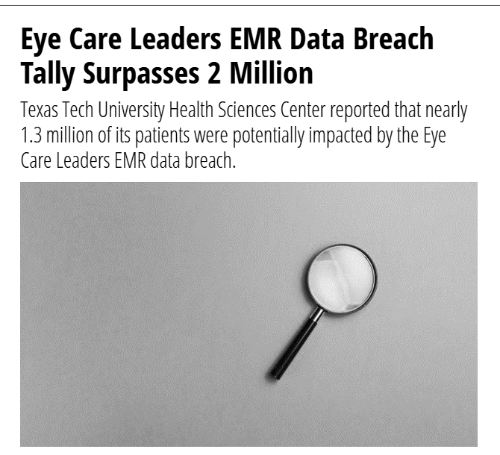
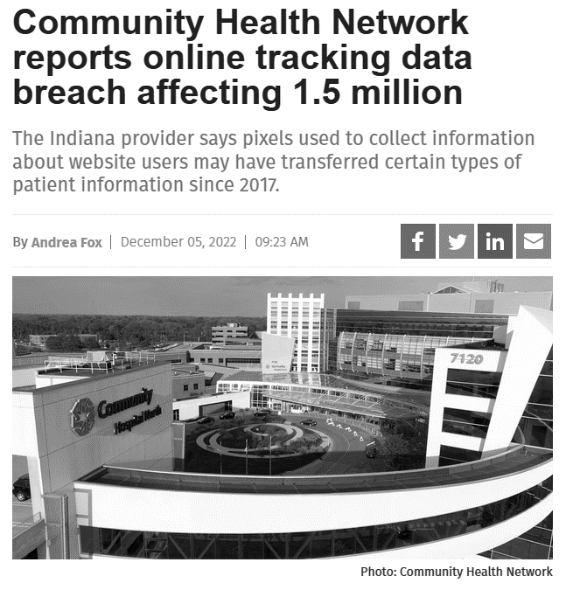
Third Party Breach Examples

Slide 9

Top 3 CISO Concerns
1
2
3

Slide 10


#1 Maturity of Security Program
What CISOs want to know
Adoption of cybersecurity framework or recognized practices
Security controls are not configured in hosted environments
How security is incorporated into the SDLC
Vulnerability management and patching
Third-party penetration testing
Common Pitfalls for Vendors
Exaggeration of what controls are implemented and/or followed
Represent SOC II or HITRUST in areas out of scope from certification
Immature HIPAA Compliance program
Maturity of Security Program, Practices & Controls
Maturity of Security Program, Practices & Controls
Can we trust that the digital health company has a reasonable and appropriate level of security program maturity?
Can we trust that the digital health company has a reasonable and appropriate level of security program maturity?

Slide 11
#2 Risk to the Organization
What CISOs want to know
Impact of this technology to business or clinical processes
Data flow in and out of the application
Whether the vendor performs on-going risk analysis
If a device, risk it brings when connected to infrastructure
Cybersecurity insurance and/or assumption of liability
Common Pitfalls for Vendors
Off-shore data storage or resources
Slow response or lack of transparency during security risk assessment
Inflexibility when it comes to risk remediation
Maturity of Security Program, Practices & Controls
Risk the Technology Introduces to Organization
Can we trust that the digital health company has a reasonable and appropriate level of security program maturity?
How much risk will the organization incur relative to the value it brings?

Slide 12
#3 Incident Response & Resiliency
What CISOs want to know
How the vendor monitors their environment for threats
The ability to detect and respond to a threat actor
Availability of the platform if an incident occurs and
The vendors ability to recover from an attack
Ability to notify and collaborate during an incident
Common Pitfalls for Vendors
Committing to terms in a business associate agreement it cannot meet
Lack of incident response plan
No business continuity or disaster recovery process
Maturity of Security Program, Practices & Controls
Resiliency of the Vendor or Technology if an Attack or Breach Occurs
Can we trust that the digital health company has a reasonable and appropriate level of security program maturity?
How well can the vendor detect, respond, and recover from an attack?

Slide 13
Managing Risk Across the Healthcare Ecosystem
Andrew Mahler & Dave Bailey

Slide 14
Emerging Technologies are Especially Worrisome
HC3 Threat Brief highlighted 5 technologies in particular:
Artificial intelligence
5G cellular
Nanomedicine
Smart hospitals
Quantum computing and cryptography

Slide 15
Managing Risk = Know Your Adversary

Slide 16
Healthcare Threat Assessment: Characteristics of The Adversary
They target
They take advantage of your weakness
They get into your network
They look for valuable information
They strike
They extort
The adversary has a very sophisticated level of expertise, is well-resourced, and can generate opportunities to support multiple successful, continuous, and coordinated attacks.
CAPABILITY
Very Low
Low
Moderate
High
Very High
The adversary seeks to undermine, severely impede, or destroy a core mission or business function, program, or enterprise by exploiting a presence in the organization’s information systems or infrastructure. The adversary is concerned about disclosure of tradecraft only to the extent that it would impede its ability to complete stated goals.
INTENT
Very Low
Low
Moderate
High
Very High
The adversary analyzes information obtained via reconnaissance to target persistently a specific organization, enterprise, program, mission or business function, focusing on specific high-value or mission-critical information, resources, supply flows, or functions, specific employees supporting those functions, or key positions.
TARGETING
Very Low
Low
Moderate
High
Very High
RELEVANCE
Possible
Predicted
Anticipated
Expected
Confirmed
The threat event or TTP has been seen by the organization’s peers or partners.
LIKELIHOOD
Very Low
Low
Moderate
High
Very High
Adversary is almost certain to initiate the threat event.

Slide 17
Managing Risk Across the Healthcare Ecosystem
Adversarial Threat
You and All your Vendor’s Security
You and All your Vendor’s Weaknesses
Likelihood of Threat Occurrence
The Impact of The Threat
Risk

Slide 18
Challenges in Vendor Risk Management

Slide 19
2021-2022 Data Review
A look at our vendor assessment data over the last two years revealed that approximately 60% of vendors assessed fell into the critical, high- and medium-risk categories
The top five categories most frequently identified as lacking conformance among critical and high-risk categories were:
  Access Control
  System and Services Acquisition
  Program Management
  Systems and Communications Protection
  Incident Response

Slide 20
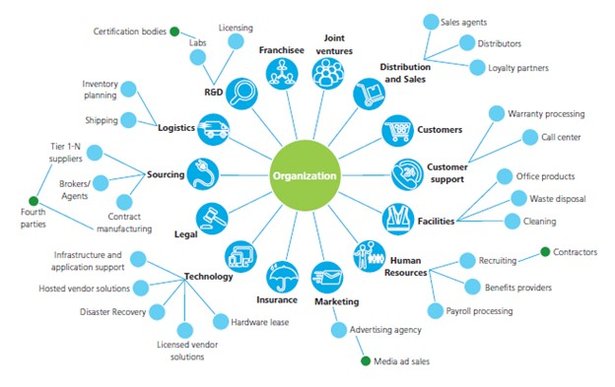
Challenges in Vendor Risk Management
Increased Complexity
Some organizations don’t have a complete and accurate list of vendors that have access to sensitive organizational data
On average, companies share their data with 583 third parties*
The prospect of starting a new program or “beefing up” an existing one without subject matter expertise can be daunting
There is a lack of perceived value versus the expertise, time and effort required to build and maintain a program
*Source: Ponemon Institute study

Slide 21

Challenges in Vendor Risk Management
Insufficient Resources
It takes money and people – something that is often in short supply and competing with other priorities
Less than 40% of organizations believe they have sufficient resources allocated to their third-party risk management
The average healthcare provider has 3.21 dedicated full-time employees spending more than 500 hours per month completing vendor risk assessments
Source: Ponemon Institute study

Slide 22
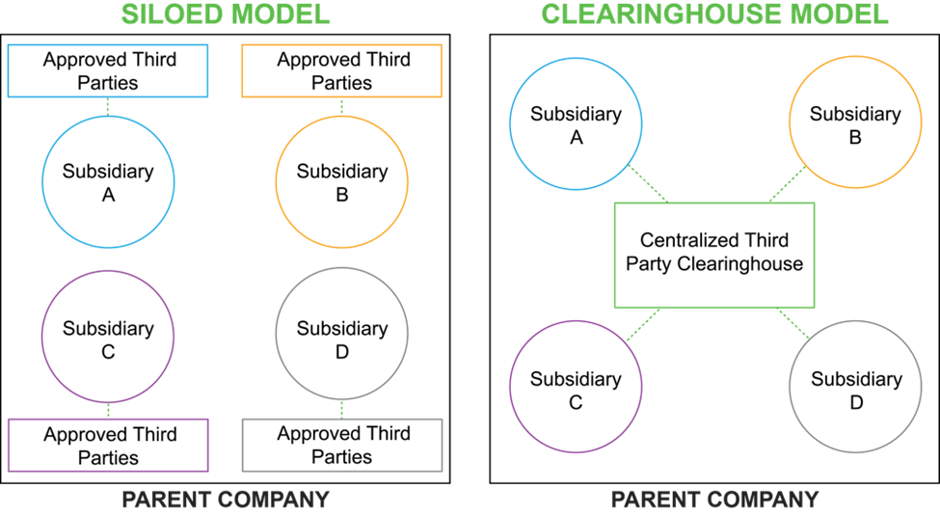
Challenges in Vendor Risk Management
Outdated Models
There is an assumption that the third party is responsible and is protecting sensitive data
Siloed business functions each assessing their own vendors, ineffective tools, and incomplete or unsophisticated assessment models all compound the problem
Third-party risk is seen as something outside the four walls, so it doesn’t get the priority it deserves
New approaches to vendor risk management have emerged in recent years, but adoption remains limited to only the highest-performing organizations

Slide 23
Developing a Vendor Risk Management Framework

Slide 24
Program Framework
Contracting
  HIPAA requires contracts with certain vendors (business associates) to include privacy and security assurances
Initial assessment and prioritization
  Identifying third-parties’ levels of access and classifying a security risk rating to each in order to identify the most impactful risks
  Prioritize vendors by inherent risk, and begin an audit with those considered to pose the highest risk
Monitoring (auditing)
  Monitoring based on the level of risk presented. For example, vendors that host PHI will warrant a higher necessity for monitoring and maintenance compared to vendors who only access PHI while onsite
Yearly re-assessments
  Conducting risk assessments and continuous monitoring enables an organization to evaluate vendor readiness to comply with security requirements and protect ePHI
Contract termination (what happens to the data – return or destruction)
  Vendor management activities do not end on the termination date specified in the BAA
  Disposition of access and retention of data, instructions for returning or destroying information

Slide 25
Established Process Improves Risk Profile
Adversarial Threat
Security Program
Weaknesses
Likelihood of Threat Occurrence
The Impact of The Threat
Risk
Rating 5
Optimized
Rating 4
Predictable
Rating 3
Established
COBIT Maturity Model
Rating 2
Managed
Continuous
improvement
is pursued
Rating 1
Performed
Performance is
measured
(quantitatively)
Rating 0
Incomplete
Process achieves its purpose and is typically well defined
Application of an incomplete set of activities
Process achieves its purpose but is largely informal
Process lacks capability or control not in place

Slide 26
Identifying and Evaluating Risks
Prioritize your vendors
Just one unregulated third-party could allow a hacker access to your entire network. It is important to be selective when choosing your vendors
  Determine the level of access needed for each of your vendors
  Adopt a “Least Privileged Model” for access
  Confirm that the internal assessments and controls of your vendors align with your organization’s assessments and controls
  Require proof of the vendor’s cybersecurity program
  Confirm that your vendors have strong security policies and procedures in place to ensure your company complies with the latest regulatory requirements
  Conduct vendor risk assessments

Slide 27
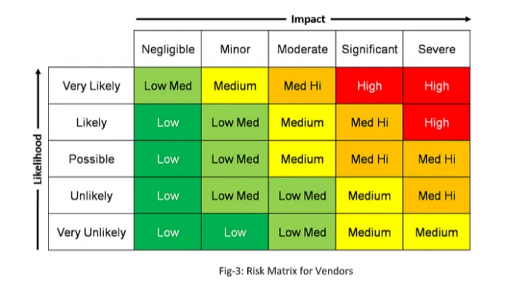
Identifying and Evaluating Risks
Type of Information accessed/used
Use of Information
Type of Access
Amount of Information
Calculate the risk
Risk = Likelihood/Probability of a Data Breach X Impact of a Data Breach (# of records and/or cost)
Assign a security risk rating
Make your riskiest vendors the priority.
Notes:
Using a methodology that has meaning for the org

Slide 28
Identifying and Evaluating Risks
Company Name
Service/Function
Access Needs
Identify your vendors
A survey of IT managers showed that 37% were unsure of the total number of vendors accessing networks
Develop a comprehensive list of vendors
Under HIPAA, any third party that comes into contact with PHI through the work it undertakes on behalf of the covered entity is known as a business associate (BA)
Every BA is a third-party vendor, but not every third-party vendor is a BA, meaning not all vendors access or use PHI
Identify the parties, nature of the engagements, sensitivity of the PHI the vendor manages

Slide 29
Responding to Risks
Evaluate Security Controls
Evaluate your vendors’ security protocols
  Security assessments (NIST CSF, HIPAA, PCI, GDPR)
  Document request
Gaining clear visibility of your vendors’ access will minimize your exposure to third-party data breaches
Encryption, firewalls, and multi factor authentication (MFA)
Password and Log-in practices
Document your controls to clearly define expectations
Audit and Monitor
Monitor your vendors: Your work isn’t done when you set controls and get vendor buy-in
  It’s your job to monitor your vendors continuously to ensure they don’t become complacent and put your data at risk
To ensure visibility of your vendors’ actions, regular security audits and in-depth report logs are imperative
  It is important to monitor the “who/what/when/where” of every individual accessing your network
By monitoring and tracking all movements on your network, you’ll be able to detect vulnerabilities and weaknesses immediately – and address them swiftly

Slide 30
In Summary
Vendor Risk Management Program
Program
  Understand your business and operations
  Determine program structure and resources
    Leverage internal resources
    Develop cohesion
  Know your risks (internal and external)
    Set threshold
    Define risk response
  Identify data classifications
  Identify current vendors
    Business associates
Framework
  Policies and procedures
  Create and/or update vendor inventory
  Contracting requirements
    Business associate agreements
  Initial assessment and prioritization
    Prioritize vendors based on risk
    Risk response
  Monitoring
  Yearly re-assessments
  Contract termination activities

Slide 31

Steve Cagle
Andrew Mahler
Dave Bailey

Slide 32



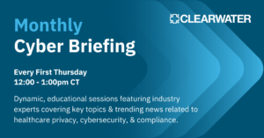
Upcoming Events
Booth #7320 & Cybersecurity
Command Center Kiosk #40
Dave Bailey presenting on April 13
Andrew Mahler presenting June 12
May 4

Slide 33
We are here to help.
Moving healthcare organizations to a more secure, compliant, and resilient state so they can achieve their mission.

Slide 34



info@clearwatercompliance.com
www.clearwatercompliance.com
1.800.704.3394

